Slide 1
Kinderfind
By Team 5

Slide 2
Table of Contents
Introduction
Expected Users
Use Case Diagram
Main Functionalities
System Architecture
Practice & Design
Sustainability
Demo
Traceability
Class & Sequence Diagram
Notes:
Going through the following:
Introduction, System architecture and demo

Slide 3
Introduction
Requirements by ZEA: Use public API from data.gov.sg to create useful app
API Selected:
Kindergarten Dataset
List of Kindergarten Services Dataset
Notes:
Based on the requirements set by the ZEA which is to use public API from data.gov.sg to create a useful app.
With this, we carefully selected these 2 APIs to work with, the Kindergarten Dataset as well as the List of Kindergarten Services Dataset.
The reason we chose this 2 dataset is because we believe in the future, these data will be very important for alot of people in Singapore.
Given the various subsidies that the government rolled out the past years to promote couples to have children,
we foresee that there will be a very high interest in finding a good kindergarten for their children too.

Slide 4





Features
View Kindergartens nearby sorted by distance
Search Kindergartens by name or tapping on map
View Kindergarten details and list
Upload ratings and review for kindergartens
Share kindergarten details with other user
Notes:
Some key features of our app:
View Kindergartens nearby by distance
Search kindergarten by name or tapping on map
View kindergarten details
Upload ratings and review for kindergartens
Share kindergarten with other users

Slide 5
Target Audience
Intended Usage
Parents
Newly Weds
Couples thinking of BTO
Preschool Teachers
One stop information app for Kindergartens
Speeds up process of searching
Able to make informed decision

Slide 6
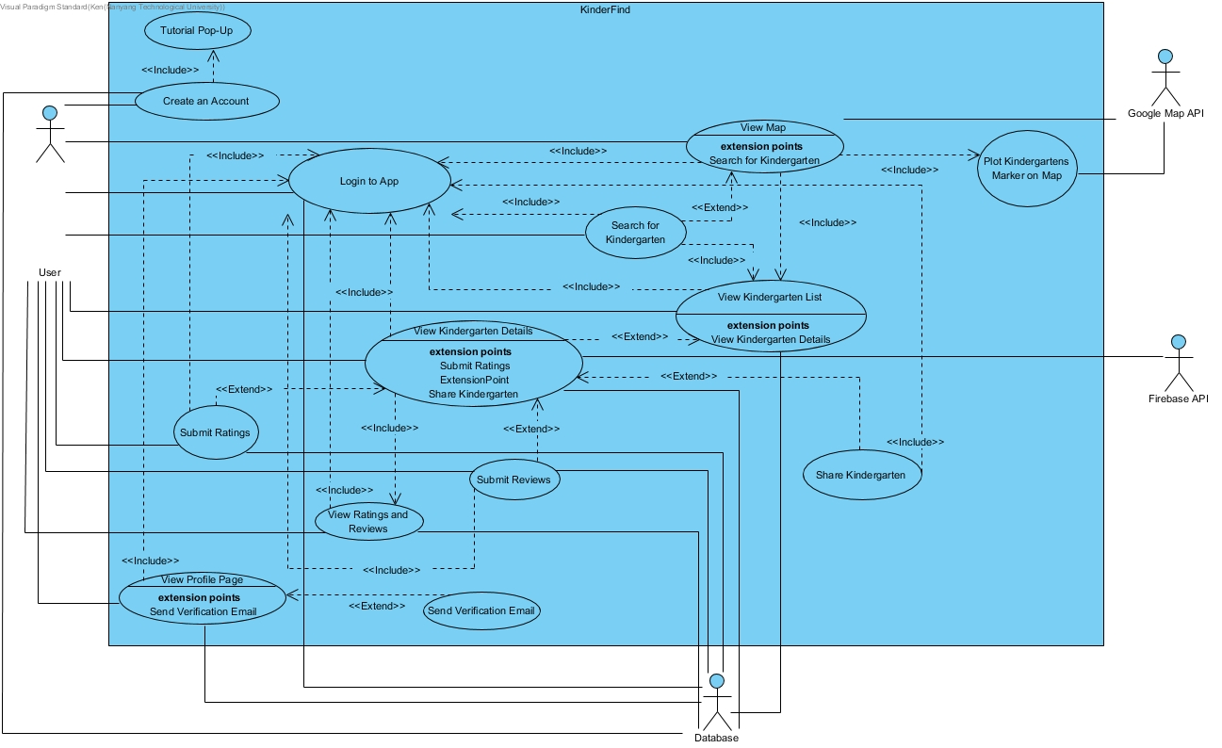
Notes:
So this is our use case diagram we have created based on all the key functionalities we believe the app should have.
The main functions will be:
Searh for kindergarten
View kindergarten details
View ratings and reviews
Submit ratings and reviews
Create an account and login

Slide 7
System Architecture
Layer architecture with Observer Pattern
Advantages:
Isolation
Separation of Concern
Notes:
The system architecture we decide to use is the Layer architecture.
This is because of the key advantage it give us which are isolation as well as separation of concern.

Slide 8
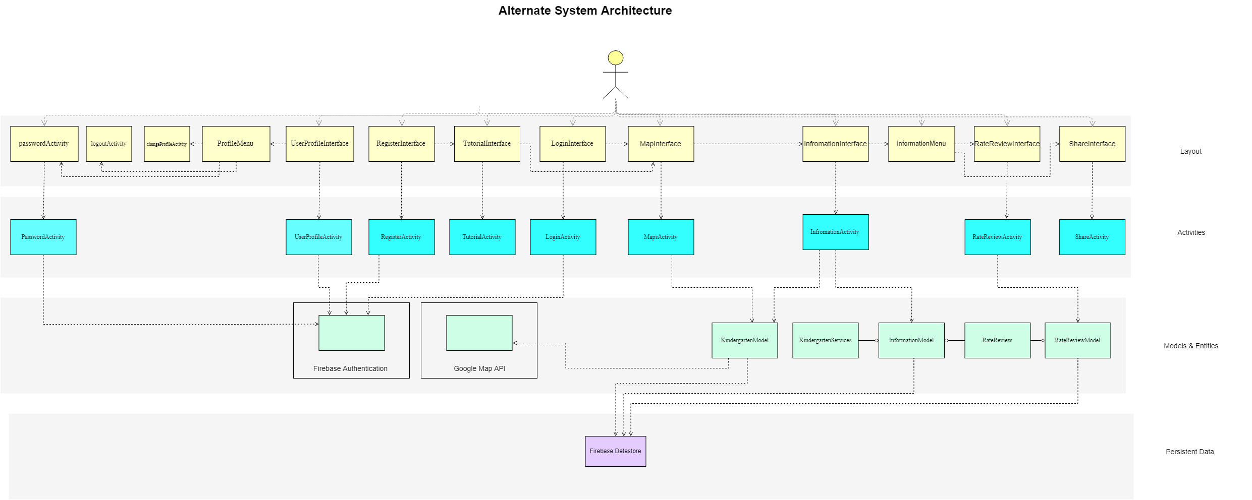
Observer
Notification
Subscription
Subject
Notes:
The primary advantages of this architecture are isolation and separation of concerns. Each layer is isolated from the others, accessible via a well-defined interface. This allows for implementation changes within the layer without affecting the other layers. Loose coupling achieved as each layer does not need to know how the other layers are implemented. It just uses them.
We also use observer pattern with layered architecture on Map, Information as well as RatingReview.
This is because we want the changes to be immediately reflected when a user made a change the page that he is on.
For the map, observer pattern is used when a user type a location in the search bar, the list of kindergarten is refreshed in real time based on what the user types.
For Information and RatingReview, these 2 are linked as when a user created or edits their rating and review on a kindergarten, this change is immediately reflected on all users.
This makes our app more intuitive and responsive.

Slide 9
Implementation
Reduce number of Classes created
User
Session
Marker
Android Studio
Java
Google Map API
Firebase
Notes:
Because everything that we are using are created by Google, everything is interconnected and works perfectly with each other. Google is able to provide multiple APIs and developer tools to help android developer to develop the app.
As reusing the existing APIs is more efficient than reinventing the wheel, we decided to use the tools Google has provided for us.
Thus, using these services, we are able to reduce the number of classes we had originally planned. We initially had to create a User, Session and Marker class. But since we are using the services provided for us, we can remove these classes in our original class diagram

Slide 10
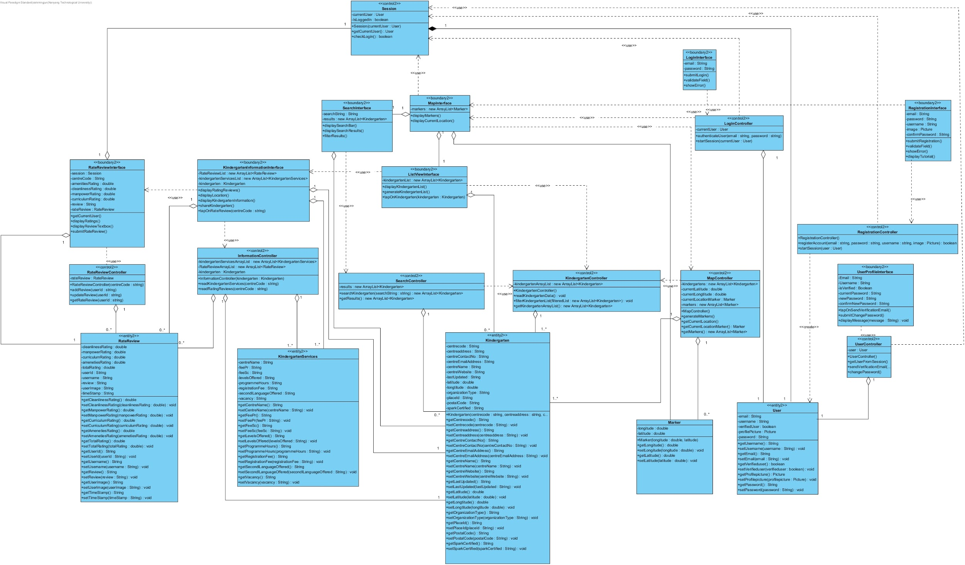
Notes:
This is what our class diagram looked like before we started coding.
We did not know how android works and created this class diagram based on our previous knowledge of OODP as well as the first part of SE.
But now that we started coding and learnt about all these useful tools that Google provides for us, we were able to merge and reduce the number of classes we actually need to create our application.

Slide 11
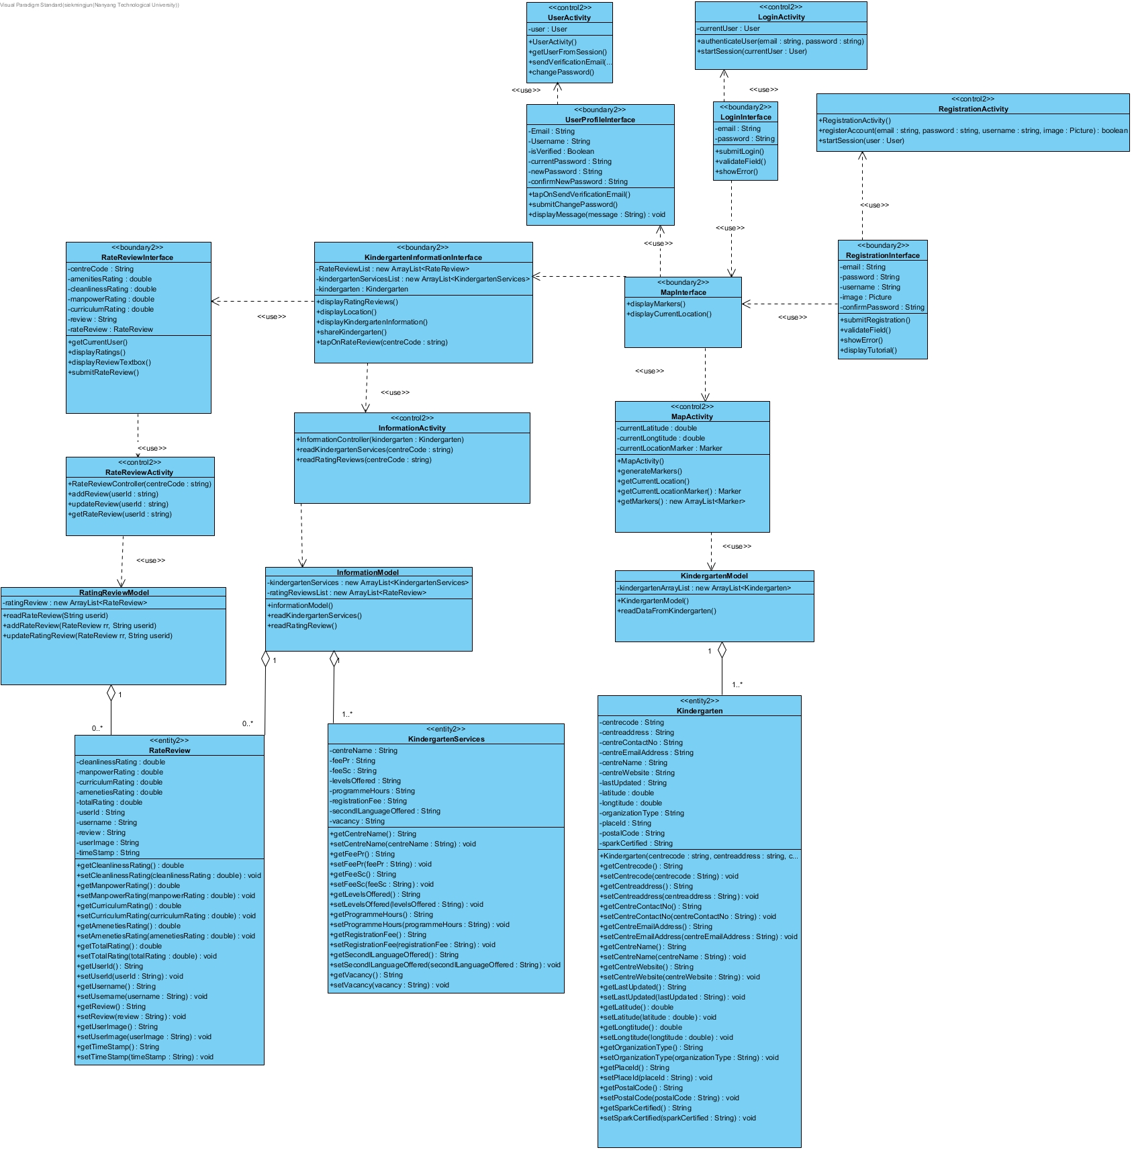
Notes:
This is what our finalized class diagram looks like now, much more compact and neater.

Slide 12
Functional & Non-Functional Requirements
App must be developed entirely in Java.
App must fetch kindergarten information when user tap on a pin.
App must fetch kindergarten information when user search using search bar.
User must be able to rate and review kindergarten
App must provide tutorial for first time user
User must be allowed to search location using kindergarten details
...

Slide 13
Traceability Demonstration
Information Page
Showcase Observer Pattern
Notes:
Class Diagram:
Talk about the classes that will be used for this function
Sequence Diagram:
For our sequence diagram, we will be focusing on the informationModel part over here. So the InformationModel will call readRatingReview() function which will retrieve all the rows inside the RateReview table. When doing so, it attaches an addValueEventListener to subscribe to any changes made to the RateReview table in Firebase.
Now, if there are any changes made to the RateReview table, Firebase will sell call it’s notify function and call onDataChange function from InformationModel. This will update the ratingReviewList to the updated list pushed by Firebase. Next, itcalls dataStatus.dataIsLoaded from InformationActivity which will use the updated ratingReviewList to refresh the rating and review section inside the Information interface

Slide 14
Blackbox Testing on Login Page
Equivalent Class & Boundary Value Testing
Length of Password (Range of Value)
Equivalent Class Testing
Email (Discrete Value)

Slide 15
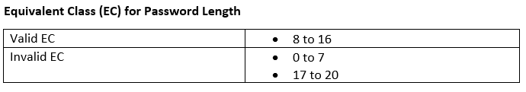
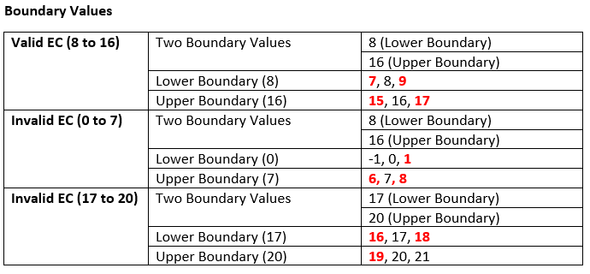
Blackbox Testing on Login Page

Slide 16
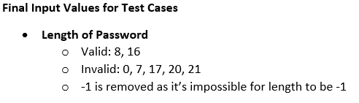
Blackbox Testing on Login Page

Slide 17
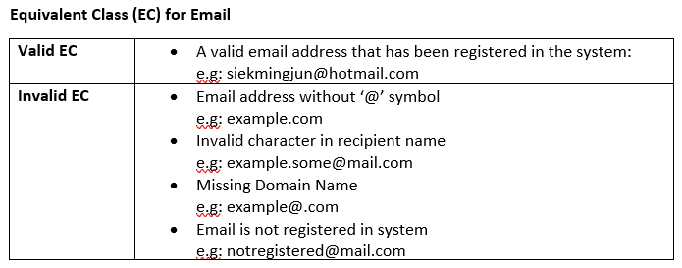
Blackbox Testing on Login Page

Slide 18
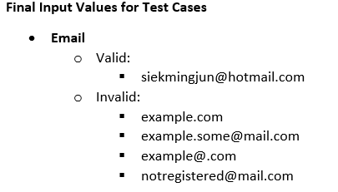
Blackbox Testing on Login Page

Slide 19
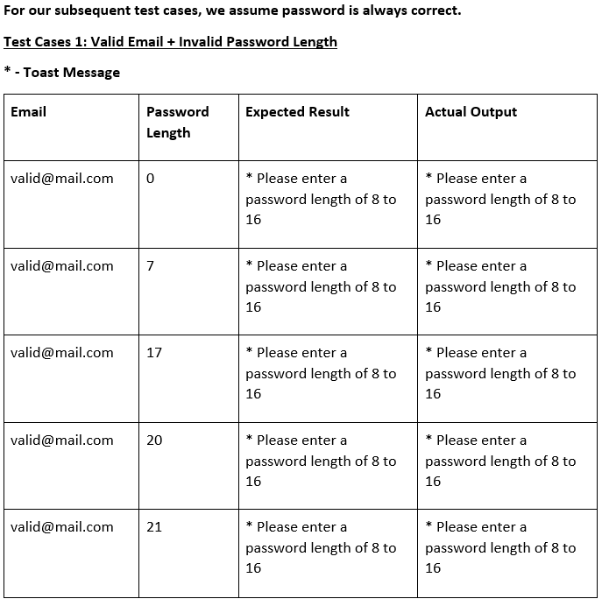
Blackbox Testing on Login Page

Slide 20
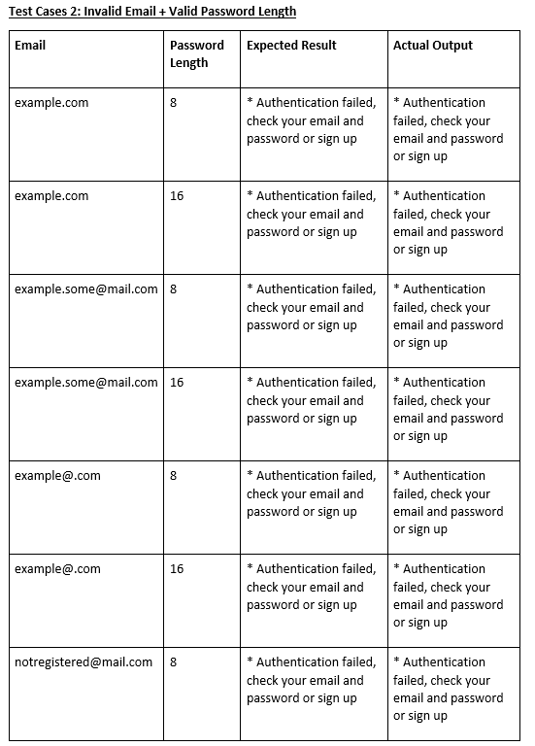
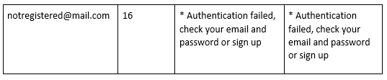
ALL TEST CASES PASSED

Slide 21
Thank You

